Slide 1

PHARAOH PERSECUTES ISRAEL
1. Midwives Oppose Pharaoh’s Evil Command (Exodus 1:15-22)
2. Pharaoh Seeks Moses’ Life (Exodus 2:5-15)
3. Israel Cries Out to God (Exodus 2:23-25)
Central Truth:
Recognize God’s favor on His people and respond with obedience to Him.

Slide 2

Introduction
The deliverance God brought about through the Exodus greatly impacted the minds and hearts of the children of Israel. They would always look back to this event as their beginning as a nation and the inauguration of their covenant relationship with God. Even today, Jewish people look back to the Exodus as the most significant incident in their history. It is remembered in song, commemorated in poetry, celebrated yearly in the Passover meal, and studied as an event of momentous historical and spiritual importance. It has been said that without the Exodus, Israel has no history. We cannot minimize the significance of this study.

Slide 3

1. MIDWIVES OPPOSE PHARAOH’S EVIL COMMAND
A. The First Murderous Order (Exodus 1:15-17)
¹⁵ Then the king of Egypt spoke to the Hebrew midwives, of whom the name of one was Shiphrah and the name of the other Puah; ¹⁶ and he said, “When you do the duties of a midwife for the Hebrew women, and see them on the birthstools, if it is a son, then you shall kill him; but if it is a daughter, then she shall live.” ¹⁷ But the midwives feared God, and did not do as the king of Egypt commanded them, but saved the male children alive.
According to verse 17, what motivated the Hebrew midwives to disobey Pharaoh’s decree? What principle should we learn from their example?

Slide 4
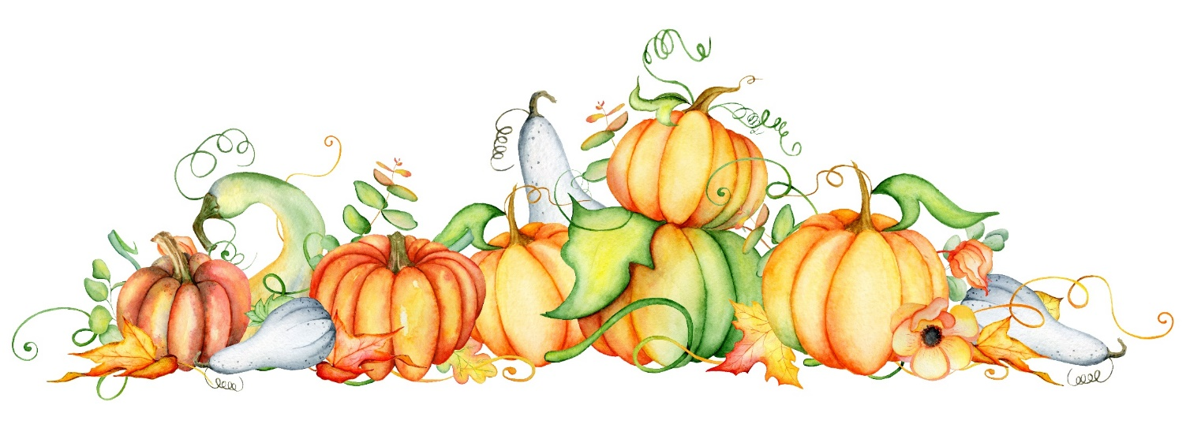
B. The Second Murderous Order (Exodus 1:18-22)
¹⁸ So the king of Egypt called for the midwives and said to them, “Why have you done this thing, and saved the male children alive?” ¹⁹ And the midwives said to Pharaoh, “Because the Hebrew women are not like the Egyptian women; for they are lively and give birth before the midwives come to them.” ²⁰ Therefore God dealt well with the midwives, and the people multiplied and grew very mighty. ²¹ And so it was, because the midwives feared God, that He provided households for them. ²² So Pharaoh commanded all his people, saying, “Every son who is born you shall cast into the river, and every daughter you shall save alive.”
God Alone
Blessed is the man who stands before the cruelest king and fears only his God.—Calvin Miller

Slide 5

2. PHARAOH SEEKS MOSES’ LIFE
A. Moses’ Life Spared (Exodus 2:5-10)
⁵ Then the daughter of Pharaoh came down to bathe at the river. And her maidens walked along the riverside; and when she saw the ark among the reeds, she sent her maid to get it. ⁶ And when she opened it, she saw the child, and behold, the baby wept. So she had compassion on him, and said, “This is one of the Hebrews’ children.” ⁷ Then his sister said to Pharaoh’s daughter, “Shall I go and call a nurse for you from the Hebrew women, that she may nurse the child for you?” ⁸ And Pharaoh’s daughter said to her, “Go.” So the maiden went and called the child’s mother. ⁹ Then Pharaoh’s daughter said to her, “Take this child away and nurse him for me, and I will give you your wages.” So the woman took the child and nursed him. ¹⁰ And
the child grew, and she brought him to Pharaoh’s daughter, and he
became her son. So she called his name Moses, saying,
“Because I drew him out of the water.”
Soft Pillow
When you go through a trial, the sovereignty of God is the pillow upon which you lay your head.—Charles Spurgeon

Slide 6

B. Moses’ Life Preserved (Exodus 2:11-15)
¹¹ Now it came to pass in those days, when Moses was grown, that he went out to his brethren and looked at their burdens. And he saw an Egyptian beating a Hebrew, one of his brethren. ¹² So he looked this way and that way, and when he saw no one, he killed the Egyptian and hid him in the sand. ¹³ And when he went out the second day, behold, two Hebrew men were fighting, and he said to the one who did the wrong, “Why are you striking your companion?” ¹⁴ Then he said, “Who made you a prince and a judge over us? Do you intend to kill me as you killed the Egyptian?” So Moses feared and said, “Surely this thing is known!” ¹⁵ When Pharaoh heard of this matter, he sought to kill Moses. But Moses fled from the face of Pharaoh and dwelt in the land of Midian; and he sat down by a well.
In verse 12, why did Moses look “this way and that way,” and then what made him fearful (v. 14)?

Slide 7

3. ISRAEL CRIES OUT TO GOD
A. God’s People Groan (Exodus 2:23)
²³ Now it happened in the process of time that the king of Egypt died. Then the children of Israel groaned because of the bondage, and they cried out; and their cry came up to God because of the bondage.
What happened “in the process of time” (v. 23), and how should this encourage us?

Slide 8

B. God Remembers His People (Exodus 2:24-25)
²⁴ So God heard their groaning, and God remembered His covenant with Abraham, with Isaac, and with Jacob. ²⁵ And God looked upon the children of Israel, and God acknowledged them.
God Cares
When the cartoon character Hobbes asks his little friend, Calvin, “Do you think there’s a God?” Calvin ponders momentarily. Then, he replies, “Well, somebody’s out to get me!”
With all the worries and troubles of life,
we may sometimes feel
like Calvin. But God does
care for us and
the troubles in our
lives. Isaiah 63:5
is still true.

Slide 9

GOD REMEMBERS HIS OWN
We live in a troubled world full of
problems, full of evil. This causes some
of us to question God. Is He there? Does
He care? One of the great takeaways from this
lesson is that God never forgets His own. His
people are precious to Him. He cares about our
misfortunes. He has compassion on us in our suffering.
Just as God watched over Israel in Egypt, heard their
cries, and gave attention to their needs, so we
can count on the Lord to take care of us. Let
this lesson encourage us to have faith in
God and His everlasting care for us.

